Slide 1
Introduction to Networking
CT043-3-1 & Version VE1
Introduction and Overview

Slide 2
Lecturer information
Lecturer Name: Keshab Raj Pokharel

Slide 3
Pre-requisites for this module
Nil

Slide 4
Aims of this module
Provide an insight into the basic concepts of data communications
Provide an understanding of networking, both Local and Wide Area Networks
Introduce students to standards and protocols used in data communication and networking and, in particular, the basic principles of the ISO-OSI Reference Model

Slide 5
Course Learning Outcomes, (CLOs)
At the end of this module, YOU should be able to:
Explain the fundamental principles of current network operation including the standards and protocols used in data communication.(C2, PLO1)
Form the local area network design and configuration using
simulation tool for the given scenario (A2, PLO6)
Work in a team to justify the topology and IP addressing plan based on the network design (A3, PLO4)

Slide 6
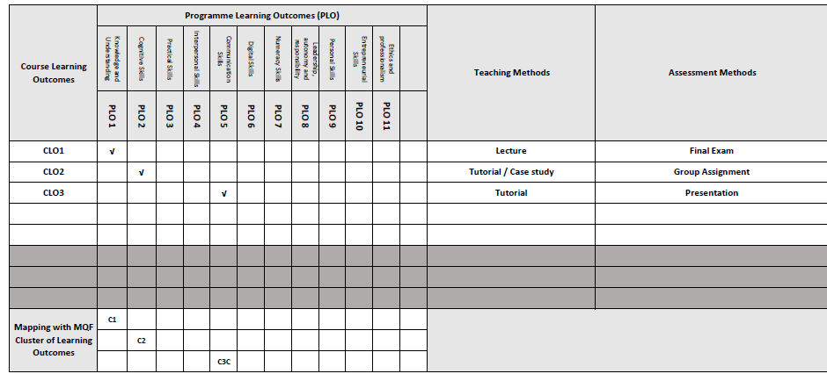
Mapping of CLOs with MOEs Domain

Slide 7
Teaching Strategies
Lecture
Tutorial
Case Study (Individual and Group)
Group Discussion

Slide 8
Assessment Methods
Final Exam (50%) : CLO1
Group Assignment (50%)
Apply suitable topology, IP addressing scheme and configuration techniques in a network design based on the given scenario (CLO)
Present network design and configuration using simulation tool (CLO3)

Slide 9
Student Learning Time (SLT)
Course Credit Value: 3
Total Learning Hours:
Lecture: 28 hours per semester
Tutorial / Case Study : 21 hours per semester
Independent Learning Time: 49 hours
** Tutorials to be conducted in Labs

Slide 10
Methods of Delivery
Hence,
We are now moving from the traditional topic-based teaching to outcome-based education

Slide 11
Outcomes Based Education (OBE)
OBE is education based on producing educational outcomes that:
Focus on what students can actually do after they are taught
Expect all learners / students to successfully achieve (sometimes minimum) level of knowledge and abilities.

Slide 12
So…What is OBE?
It’s
NOT
What we want to teach,
It’s
What You should learn

Slide 13
Course Content Outline
CLO1 : Final Exam (50%)
Lecture
Introduction to Networks
Network Protocols and Communications
Network Access
Ethernet
Network Layer
Transport Layer
Application Layer
Tutorial
Data Communication Concepts
OSI Model and TCP/IP model

Slide 14
Course Content Outline
CLO2 & CLO3 : Group Assignment (50%)
Tutorial / Case Study / Group Discussion
Configure Network Operating System
IP Addressing
Case Study : Subnetting IP Networks
Build a Small Network
Topology / Transmission Medium / Network Devices
Networking Trends
*to be conducted in labs

Slide 15
What is expected of you
You should abide to all the rules & regulation of APU
Proper attire
No speaking of dialects
Attendance is compulsory and valid medical certificates or letters from parents /guardians must support any absence from class.
Three lateness will be equal to one absence
All pagers and handphones should be turned off during lectures.

Slide 16
What support is available for you
Consultation hours
Resources
Reference material
Essential Reading
Cisco Networking Academy (2016). Introduction to Networks V6 Companion Guide. United States: Cisco Press. ISBN: 978-1587133602.
Lammle, T. (2016). CCNA Routing and switching Complete Study Guide. 2nd ed. Indiana: Sybex (Wiley). ISBN: 978-1119288282.
Internet resources
- Access to Cisco Networking Academy Platform - CCNA 1.
- Cisco Packet Tracer.

Slide 17
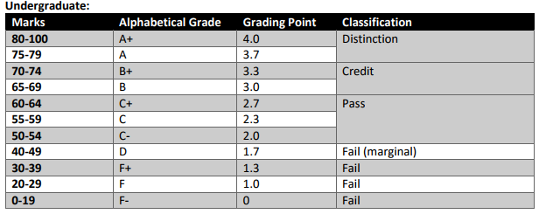
Achievement requirements

Slide 18
Question and answer session
Q & A

Slide 19
What we will cover next
Introduction to Networks

